Slide 1
Lab 1.0
Setting Up Python

Slide 2
I. Setting Up Anaconda
Anaconda is a Python distribution. It provides the Python language, packages, and package management. Overall, Anaconda makes Python easier to use. When you install Anaconda, you will also install Python.
This section of the lab provides step-by-step instructions for getting started with Anaconda.

Slide 3
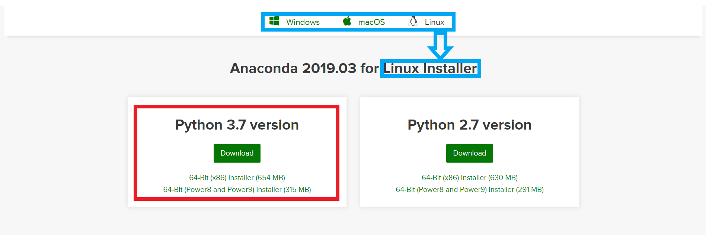
I. Setting Up Anaconda
1. Downloading Anaconda
Open https://www.anaconda.com/distribution .
In the middle of the page, choose your operating system (Windows, Mac, Linux - boxed in blue below). Make sure that the correct operating system is selected before downloading Anaconda.
Click the "Download" button for the Python 3.7 version (boxed in red).

Slide 4
I. Setting Up Anaconda
2. Installing Anaconda
Click the link from the list below for your operating system (Windows, Mac, or Linux). This will take you to the documentation for installing Anaconda. You have already completed Step 1 in this documentation by downloading Anaconda. Follow the rest of the directions carefully. You do not need to complete the optional steps, but be sure to complete step 15 to ensure that Anaconda was installed correctly.
Windows: http://docs.continuum.io/anaconda/install/windows/
Mac: http://docs.continuum.io/anaconda/install/mac-os/
Linux: http://docs.continuum.io/anaconda/install/linux/

Slide 5
II. Getting Started with Jupyter Notebooks
Jupyter Notebooks are a way to write and run Python code. By installing Anaconda, you have access to Jupyter Notebooks. They allow you to break up code into "cells" and run these cells individually.
This section of the lab will help you get started with accessing, creating, and running Jupyter Notebooks.

Slide 6
II. Getting Started with Jupyter Notebooks
1. Accessing Jupyter Notebooks
Unix Shell
We will use basic Unix Shell commands to open Jupyter Notebooks. If you are new to the Unix Shell, see this tutorial for learning about the Unix Shell: http://swcarpentry.github.io/shell-novice/ .
For a summary of the key points of the Unix Shell, see https://swcarpentry.github.io/shell-novice/reference/ .
To navigate around the Unix Shell, these are the commands that you will need:
cd path changes your directory
ls path lists your directory
cd ... moves back a directory
pip install in Anaconda prompt, installs a package
pip list in Anaconda prompt, lists all installed packages
For a complete list or further explanation: https://swcarpentry.github.io/shell-novice/reference/ .

Slide 7
II. Getting Started with Jupyter Notebooks
1. Accessing Jupyter Notebooks
Creating/Opening Jupyter Notebooks
Create a folder that you will store all files for this class. For ease of access, I recommend creating the folder under "Windows (C:)" then "Users" then "Your Username". Do not include spaces in the name of your folder. I named my folder “data-analysis”.
Search "terminal" or "anaconda prompt" in your computer's search bar to find the Command Prompt or Anaconda Prompt. Open one of these programs (Anaconda Prompt recommended).
Navigate to the folder that you created in step one using the commands provided above in the "Unix Shell" section.

Slide 8
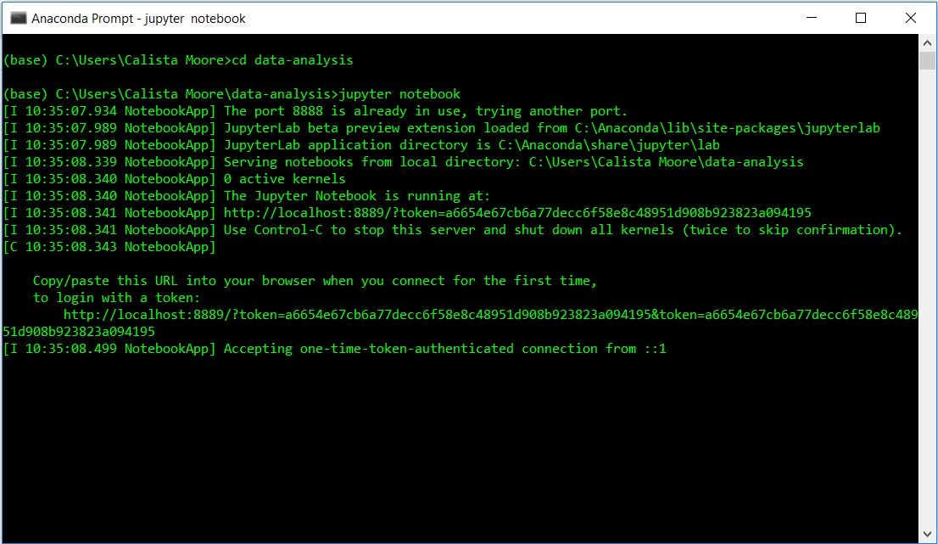
II. Getting Started with Jupyter Notebooks
1. Accessing Jupyter Notebooks
Your command prompt should look something like this:

Slide 9
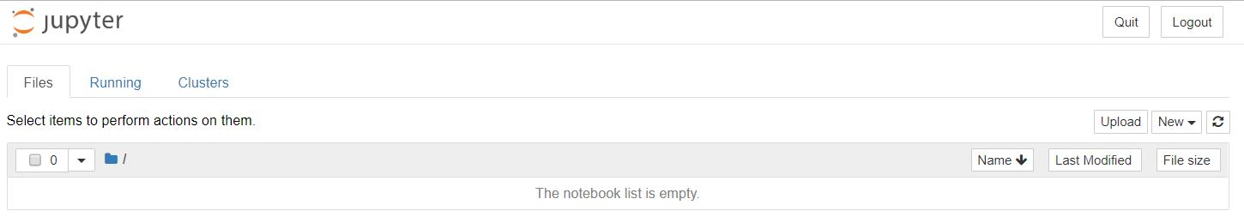
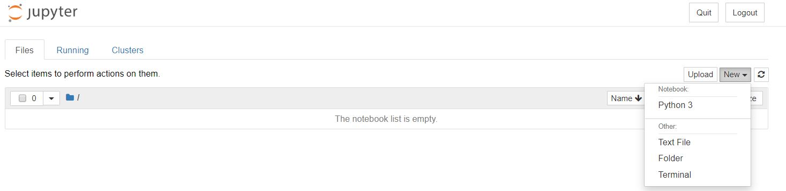
II. Getting Started with Jupyter Notebooks
1. Accessing Jupyter Notebooks
A tab with the Jupyter interface will open in your browser.
Create a new Jupyter Notebook by selecting "New" in the upper right hand corner and then "Python 3".

Slide 10
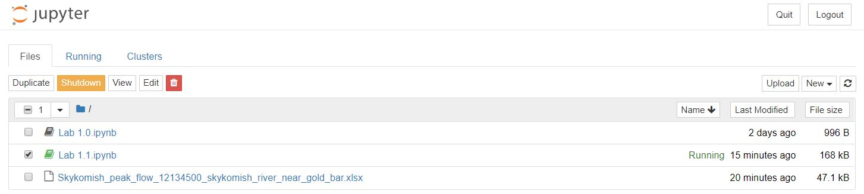
II. Getting Started with Jupyter Notebooks
1. Accessing Jupyter Notebooks
You have now created a Jupyter Notebook which you can run Python code in. The next labs will provide you with some basics of Python coding. See the "Resources to Learn Python Programming" for more, including tutorials, glossaries, and documentation.
To close the Jupyter Notebook and the interface, save your notebook and return to the interface. Select your notebook and click "Shutdown. Then, click "Quit" in the upper right hand corner of the interface page. You can now also close the Anaconda Prompt or terminal.

Slide 11
II. Getting Started with Jupyter Notebooks
2. Running Jupyter Notebooks
More on running Jupyter Notebooks will be covered in future labs. If you would like an overview of how Jupyter Notebooks run/work, this article provides some information: https://www.codecademy.com/articles/how-to-use-jupyter-notebooks-py3

